Slide 1
System and Cyber Security
L. Budi Handoko, M.Kom. (handoko@dosen.dinus.ac.id /
handoko@dsn.dinus.ac.id)
Dian Nuswantoro University

Slide 2
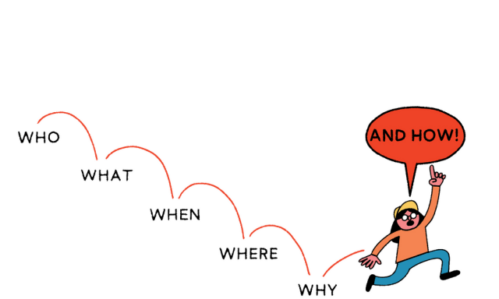
Cyber Security (System Security)

Slide 3
About Cyber Security (What)
Cyber security refers to the technologies and processes designed to protect computers, networks and data from unauthorized access and attacks delivered via the internet by cyber criminals.
It is important for securing the network, data and application including hardware, software and brainware.
The objective is to establish rules and measure to use against attack over the internet.

Slide 4
More About Cyber Security (Why)
Protect vital information while still allowing access to those who need it
Trade secrets, medical records, etc.
Provide authentication and access control for resources
Ex: AFS, NFS, etc.
Guarantee availability of resources
Ex: 5 9’s (99.999% reliability)

Slide 5
Who is vulnerable ?
Financial institutions and banks
Internet service providers
Pharmaceutical companies
Government and defense agencies
Contractors to various government agencies
Multinational corporations
ANYONE ON THE NETWORK

Slide 6
W H E N
W H E R E
H O W

Slide 7
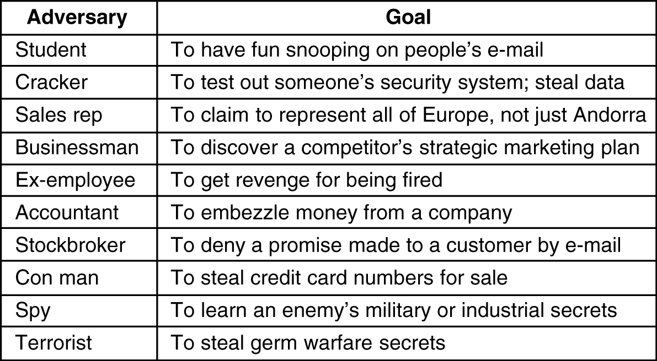
Who Need for Security ?
Some people who cause security problems and why.

Slide 8
Attack Motivation
Criminal
Criminal who use critical infrastructure as a tools to commit crime (motivation : money, heist)
War Fighting / Espionage / Terrorist
What most people think of when talking about threats to critical infrastructure (Watch : Die Hard 4)
Destroy data and information
Corporate espionage (Huawei)
Patriotic / Principle
Large groups of people motivated by cause – be it national pride or a passion aka Anonymous (Hacktivism)
Recognition and Achievement
Job Related
Penetration Test by White Hat

Slide 9
Attack Motivation
Nation States want SECRETS
Watch : Snowden
Organized criminals want MONEY
Watch : Die Hard 4
Protesters of activists want ATTENTION
Watch : Mr. Robot
Hackers and research want KNOWLEDGE
Watch : Tomorrow Never Dies

Slide 10
Data Breach Root Cause
"81% kebocoran data itu hanya gara-gara user password-nya itu berhasil diambil sama orang lain kemudian dijual, entah di dark web atau dimanfaatkan untuk dirinya sendiri," - Cyber Security Specialist Cisco System Indonesia Arief Santoso, Rabu (23/9/2020).
Deliberate
Non Deliberate
The “Insider” who leaked the data
Service providers or system developers who sell data
SOP violation on system maintenance process (System Glitch or Human Error)
Hacker attack for data breach or stealing
Users inability to safeguard their own data (weak password, less anticipation)

Slide 11
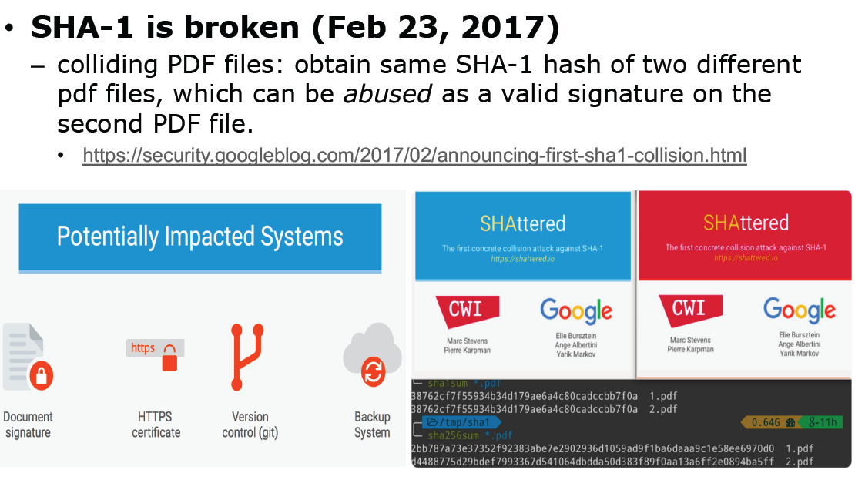
Recent Incidents

Slide 12
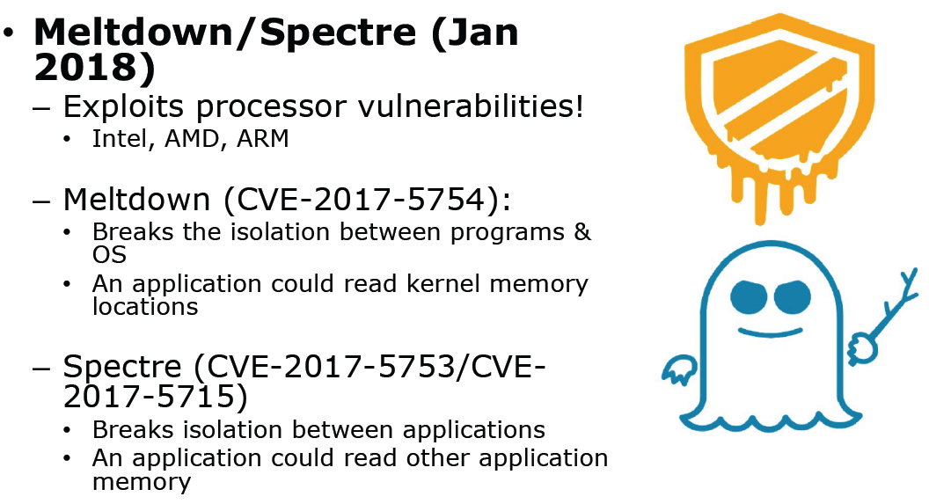

Slide 13
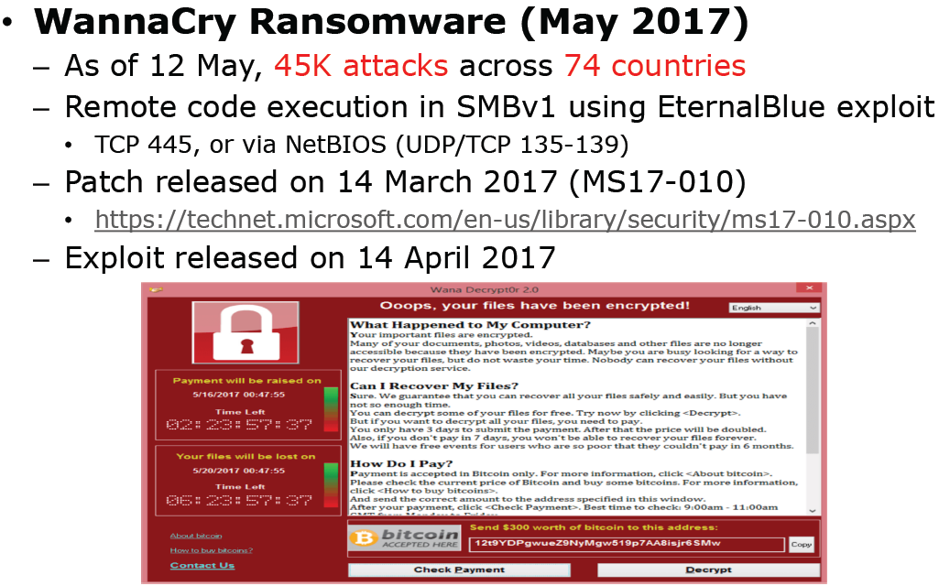

Slide 14
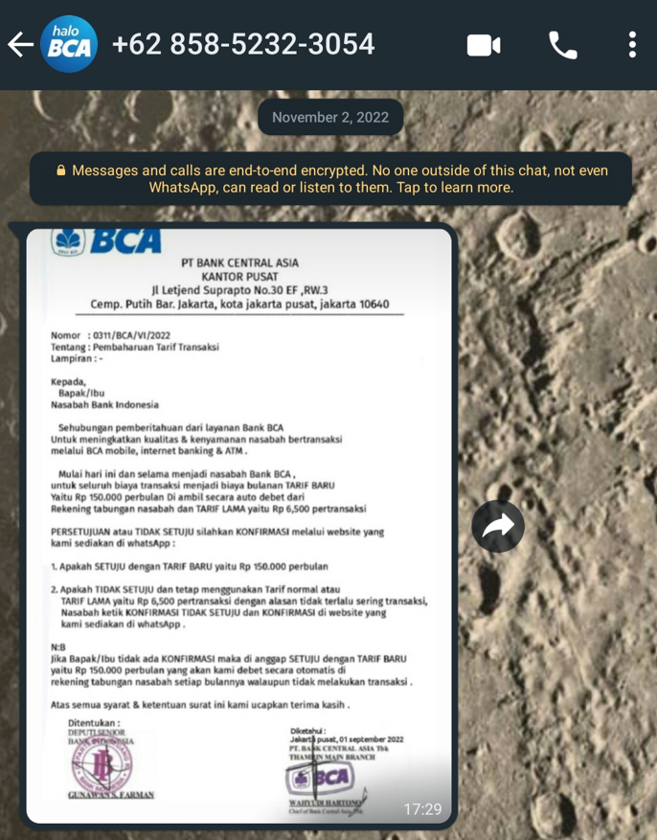
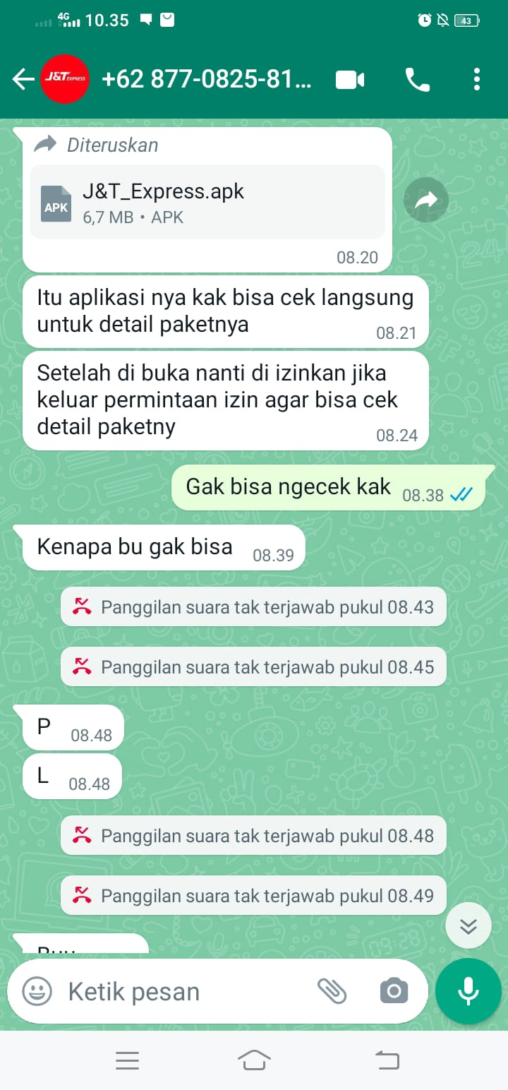
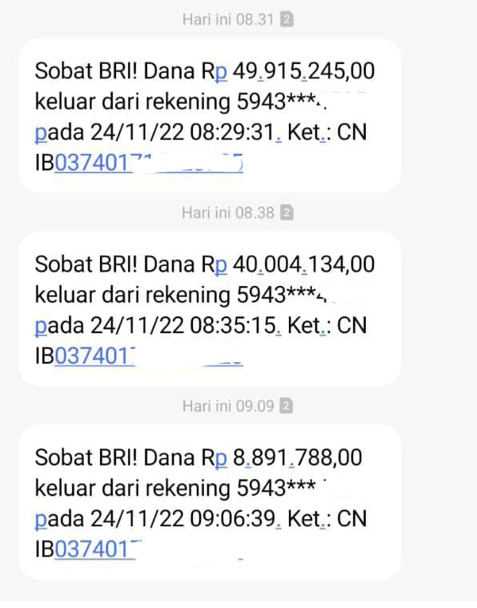
Mutasi Modus :
Foto Paket
Undangan Pernikahan
Surat Tilang ETLE
Bukti Transfer
Tagihan Internet
Lowongan Pekerjaan
Dan seterusnya…

Slide 15
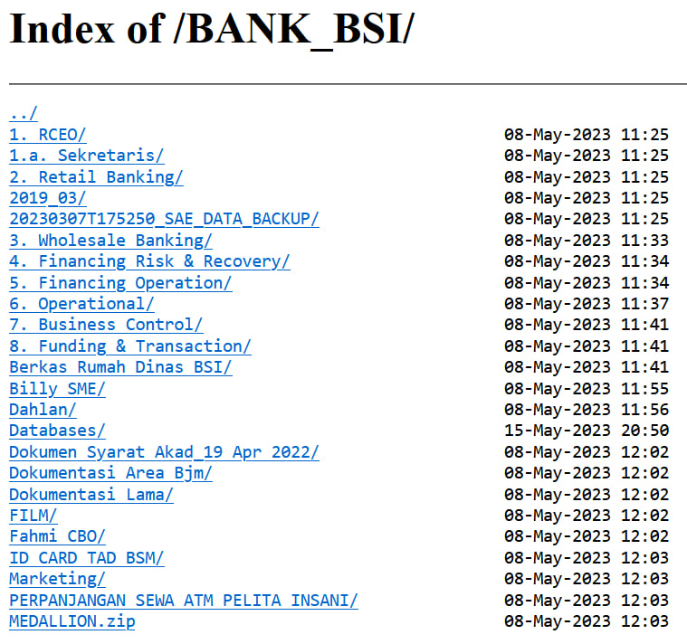
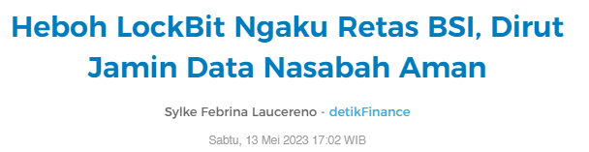

Slide 16
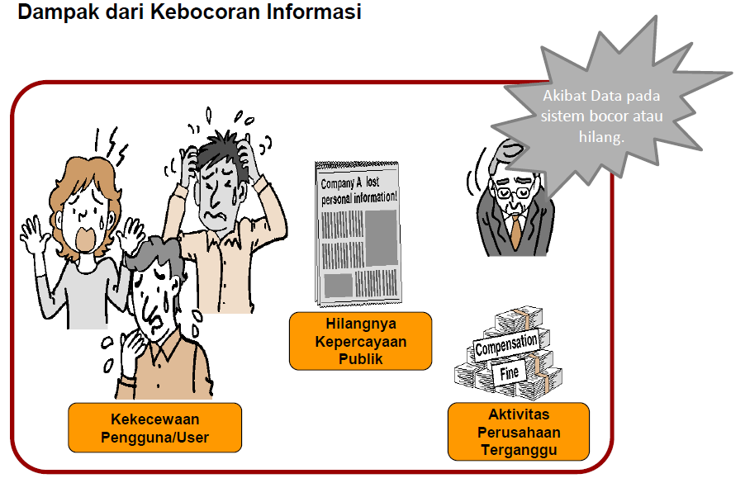

Slide 17
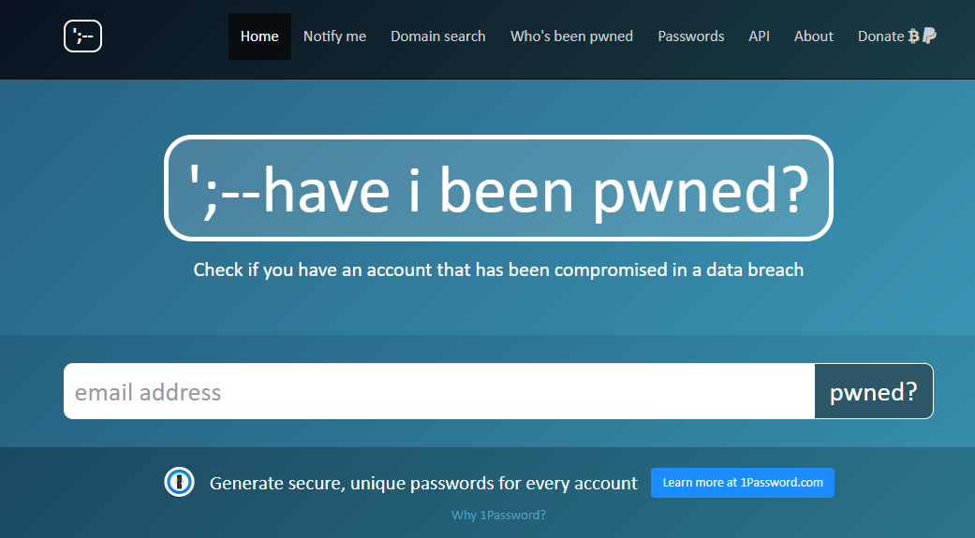
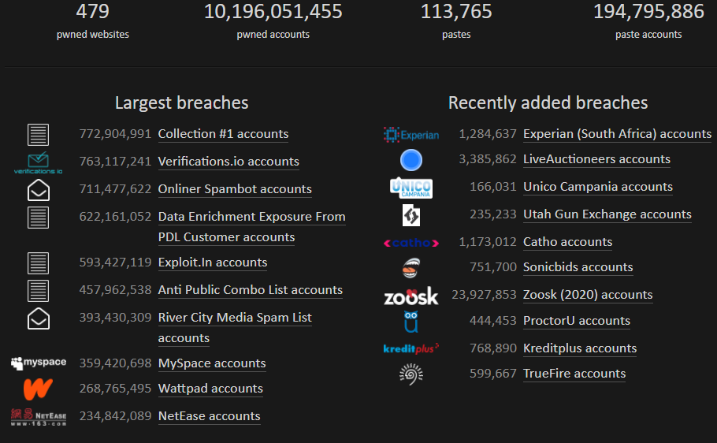
Cek apakah e-mail anda pernah jadi target
https://haveibeenpwned.com/
Alternatif : https://www.avast.com/hackcheck

Slide 18
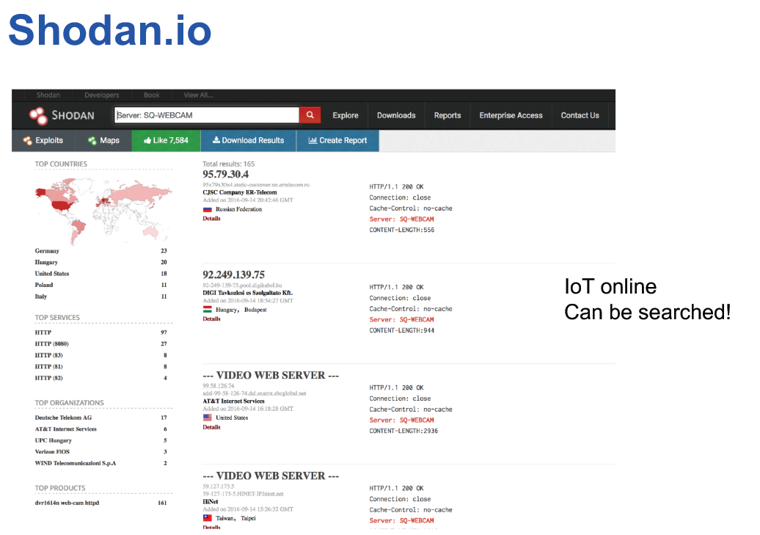

Slide 19
Cyber Attack Map (Live)
https://cybermap.kaspersky.com/
https://threatmap.checkpoint.com/
https://www.spamhaus.com/threat-map/
https://threatmap.fortiguard.com/
https://www.fireeye.com/cyber-map/threat-map.html
https://threatmap.bitdefender.com/
https://securitycenter.sonicwall.com/m/page/worldwide-attacks
https://threatbutt.com/map/

Slide 20
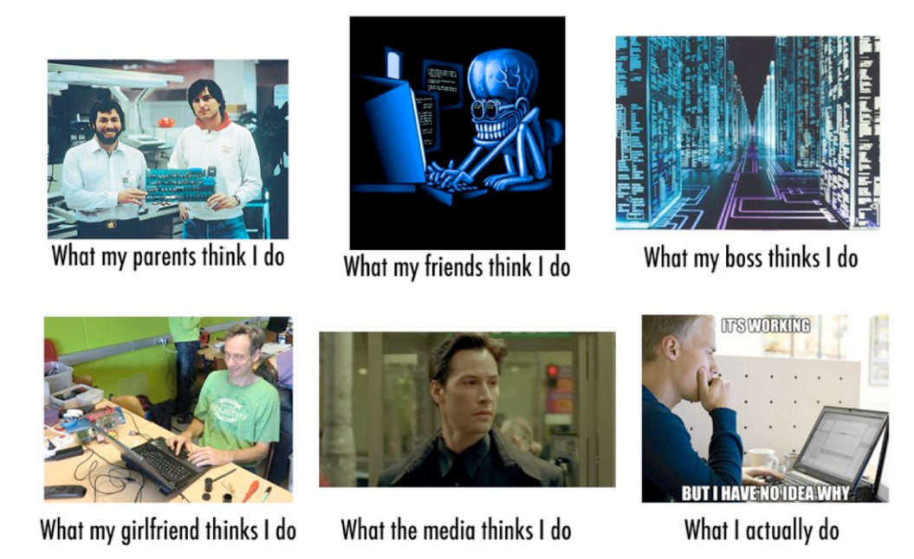

Slide 21

Any Question ?
Anything to discuss ?

